Slide 1
Group Chief Audit Officer Update
Board Audit Committee
Date: 11 December 2025

Slide 2
Group Internal Audit Update
Executive Summary : Provide the Board Audit Committee with a comprehensive update on audit progress for FY2025 and present the proposed audit strategy and priorities for FY2026 and beyond.
Annual Audit Plan & Universe
Team Update
FY 2025 Audit Plan Overall Status on Slide # 4.
Manpower Capacity Planning updated to align with FY 2026 Audit Universe and Risk-Based Audit Plan, ensuring optimal resource allocation across all planned reviews, presented under Agenda item 4.2
FY 2026-28 Audit Planning Re-assessed Audit Universe and Risk-Based
Audit Plan for FY 2026 presented for approval under Agenda item 4.2.
Management Actions
QAIP
Risk Trends Dashboard presented on Slide # 9 and 10.
Quality Assurance & Improvement Program progressing well, reinforcing standards and continuous improvements, summary presented on Slide # 18.
Management Actions Ageing on Slide # 12 and Updates on Overdue on Slide # 13.
Summary on extensions of management actions presented on Slide # 15.
Management Actions Deep dive of Open Actions for the Group presented under Agenda item 4.3.
Functional & Regulatory Updates
Summary of CBUAE related actions closures and GIA's validation are shared on Slide # 16.
Key findings and risks of recent audits are being presented on Slides #
5 to 8.
CBUAE limited scope examination on Control Functions. Status Update of actions raised on GIA presented on Slide # 17.
Audit reports are uploaded onto Convene Reading Room and presented under Agenda item 7 – Annexure 7.3.

Slide 3

FY 2025 at a Glance
FY2025 delivered measurable uplift across audit execution, risk coverage, reporting timelines and regulatory alignment — supported by the integration of analytics and stronger closure discipline across the enterprise.
Performance Metric
FY2025
FY2024
Trend
Total Audits planned
38
35
▲ 9%
Total Audits deferred to following year
2
4
▼ 50%
Audit Plan Completion Ratio as of year end
90%^
71%
▲ 19 pts
Coverage of High-Risk Auditable Entities
100%
83%
▲ 17 pts
Continuous Monitoring / Dashboards
4 dashboards live
-
▲ 100%
GIA Action Closure Validations Completed YTD#
798
440
▲ 358 actions
CB UAE Action Closure Validations Completed
84*
135
▼ 51 actions
*4 Additional CBUAE Action Closure Validations to be Completed by YE 2025
^ Estimated % based on audits expected to be delivered by YE 2025
# Actions excludes those related to RAKislamic and RAKINSURANCE divisions, including actions from GIA audits; AFIs and unrated actions are also excluded.
Key Takeaway: FY2025 delivered a step-change in audit execution; higher coverage, faster cycle times and materially stronger management actions validations, reflecting a more integrated and data-enabled assurance function.

Slide 4
FY 2025 Audit Plan – Status Update
Audit Plan
ADHICS Compliance
S# | In-flight Audit name | Status | Expected Completion
1. | ADHICS Compliance | Reporting | December 2025
2. | Skiply (I) | In Progress | December 2025
3. | Annual Credit Risk Management Standards
4. | Group Human Resources | In Progress | January 2026
5. | Investments & Trading & Market Risk
6. | Financial Crime Compliance (I)
7. | EIBOR
Reporting
In Progress - Expected Completion Dec 2025
Skiply (I): Target to complete audit by 31st December, subject to stakeholder support but slight delay is anticipated due to year end.
Annual Credit Risk Management Standards: Process reviews commenced with the preparation of Audit Work Program.
^
39
In Progress - Expected Completion Jan 2026
Group Human Resources: Fieldwork is in progress, and the report is expected to be finalized by 10th January 2026.
Investments & Trading & Market Risk: The audit is in progress. Process walk-throughs continue.
Financial Crime Compliance:
Planning and expected to move to fieldwork by mid-December. Audit delivery is targeted for January-end 2026.
EIBOR: Fieldwork expected to commence post mid-December 2025.
*IP – In Progress
Completed Audits – Rating Distribution
32
Roll Forwarded to FY26
Financial Planning & Budgeting | Regulatory Reporting (BRFs)
^ Branches Audit split into 4 standalone audits with separate ratings, raising the total # of audits from 38 to 41. Considering 2 management requested deferrals, total comes down to 39.

Slide 5
Summary of Key Findings and Risk (Audit Reports Issued Post BAC # 4 ~ 23rd October 2025)
Audit Report | Key Findings and Risks | Action Plan/Status
Fixed Assets
M
NI
Fixed Assets Governance and Policy Gaps [ECD: 30/09/2026] The Fixed Asset Management Framework lacks clearly defined roles and responsibilities across Finance, IT, and Administration for managing the entire fixed asset lifecycle from acquisition and tagging to movement, physical verification, and disposal. | All the findings will be addressed with ERP implementation. SOP/Roles and responsibilities will be defined during ERP implementation and SOP will be formalized as part of the ERP roll out. The document intends to demonstrate clear roles and responsibilities between different functions i.e. Finance, Admin and Procurement.
B. Irregularities in Fixed Assets Accounting Manual and Processes [ECD: 30/09/2026] Fixed Assets Accounting Framework lacks defined processes and accountability for updating asset records, clear classification criteria, and documented procedures for applying revised useful lives, resulting in inconsistencies between manuals, system data, and financial disclosures. | All the findings will be addressed with ERP implementation. SOP/Roles and responsibilities will be defined during ERP implementation and SOP will be formalized as part of the ERP roll out. The document intends to demonstrate clear roles and responsibilities between different functions i.e. Finance, Admin and Procurement.
C. Control Gaps in Fixed Asset Management Across Store Facilities [ECD: 31/01/2026] Physical asset storage lacks adequate environmental controls, documented inspections, and robust security measures, with noted deficiencies in offsite facilities and internal storage areas. | Offsite storage will improve containment, increase disposal frequency to every three months, and implement basic environmental and fire safety measures with documented inspections. Internal storage areas will maintain CCTV and access controls with enhanced security checks.
M
M
Ref: Annexure 7.5
Model Management
Status of the Model Management Standards and Guidance Gap Analysis [ECD: 31/03/2026] Delay in complying with the model management regulation and informing the Regulator about the implementation progress may lead to a greater scrutiny. In addition, no LGD model development plan is in place. | The BMRC decision is taken to properly notify the CBUAE about the remediation status to reach compliance with the model management requirements. A standing agenda item for the overall development and validation plan, including LGD redevelopment, will be included in the model management reporting.
B. Issues in the Model Identification Process [ECD: 30/06/2026] Insufficient internal awareness about the model framework and criteria could affect effectiveness of model risk identification and management. | The Model Governance standard is approved and under the implementation to remediate issues noted. Risk initiated Model Roadshow Awareness sessions that would cover all relevant teams in the Bank.
C. Documentation and Governance Around ECL Management Overlays [ECD: 31/03/2026] Lack of sufficient documentation and governance around management overlays may not facilitate a coordinated model remediation and any independent review. | Risk and Finance team work together to enhance and implement missing governance aspects around management overlays for expected credit loss.
NI
H
M
M
Ref: Annexure 7.6
*ICD/ECD: Interim/Estimated Completion Date
NI : Needs Improvement | Satisfactory | U : Unrated
 | High Risk
 | Medium Risk
5

Slide 6
Summary of Key Findings and Risk (Audit Reports Issued Post BAC # 4 ~ 23rd October 2025)
Audit Report | Key Findings and Risks Action Plan/Status
RBG Collections & Recovery
H
NI
Powers of Attorney (POA) [ECD: 30/11/2025] Gaps in POA governance and lifecycle management, including active POAs after staff transfers or exits, sub-delegated POAs without defined expiry dates and bypassing the Admin Department process, and external legal consultants’ POAs exceeding approved tenure or remaining expired without timely renewal. | Cancel outdated POAs, review and update sub-delegated and external POAs with proper expiry and registration, maintain an updated POA register, and strengthen coordination between relevant units.
B. Data Governance Over Sensitive Customer Information [ICD: 31/12/2025] Weaknesses in data governance, where sensitive customer information is stored in shared folders accessible to over 131 users, some with modify rights and without clear business justification. | Review and rationalize user access to shared folders, ensuring alignment with business needs and principle of least privilege. Risk exemption processes will be updated or new approvals obtained for sensitive data handling.
C. Auto Loan – Legal and Repossession [ECD: Closed] Vendor due diligence is not performed on Emirates Auction LLC for repossessed vehicle storage. Furthermore, two vehicles unrelated to the Bank have occupied storage space since 2018, leading to unnecessary costs and potential liability. | Validated compliance with the vendor due diligence process as required under the Bank’s Third-Party Risk Management (TPRM) and Outsourcing Policy and coordinated with Emirates Auction to update the Bank’s registers and remove vehicles incorrectly tagged to RAKBANK from its storage arrangement.
M
M
Ref: Annexure 7.7
Digital Banking
A. Weak Privilege Access Revocation Process [ICD: 31/03/2026] Database administrators retained elevated privileges for five months after the DR period without timely revocation or access review. This increases the risk of unauthorized changes and non-compliance with access control standards. | Access revocation was missed, which has been rectified now. Going forward the HD ticket through which elevated privileges are granted will not be closed in future until access has been revoked
B. Insufficient SIEM Correlation for Web Application Security [ECD: 31/03/2026] Security Incident Event Management (SIEM) lacks correlation rules and integration for web application security events, limiting visibility and proactive monitoring. | Web server logs will be integrated with SIEM, and correlation rules will be added for web application firewall logs.
NI
M
M
Ref: Annexure 7.8
Corporate Banking (WBG) – Customer Fulfilment
Shareholder update for existing syndicated borrowers [ECD: 31/03/2026] Related party details in the Core Banking System are updated only for New to Bank borrowers and not for existing borrowers for syndicate loans. | Process for existing cases will be revisited, and OP will be updated. Exception reports will be developed as necessary to identify anomalies.
B. Documentation and Covenants update [ECD: 31/03/2026] Weaknesses were noted in the documentation and covenant update process which could lead to gaps in systematic monitoring, lack of escalation for non-compliance, and reduced visibility of early warning signals. | Since completed and updated in the system. Going forward, a process is implemented to ensure that all document details are updated in Finacle prior to disbursal.
NI
H
M
Ref: Annexure 7.9
*ICD/ECD: Interim/Estimated Completion Date
NI : Needs Improvement | Satisfactory | U : Unrated
 | High Risk
 | Medium Risk
6

Slide 7
Summary of Key Findings and Risk (Audit Reports Issued Post BAC # 4 ~ 23rd October 2025)
Audit Report | Key Findings and Risks Action Plan/Status
Wealth Management & LAI
M
NI
Key Fact Statements [ECD: 28/02/2026] The Key Fact Statements for Wealth Management Products do not include adequate warnings, disclosures of key risks, absence of notice period for changes in terms, and lack of clarity on early settlement provisions for lending products. | Hyperlink for Terms and Conditions (T&Cs) will be included in all KFS and Lending Against Investment T/Cs will be made available on the Bank’s website.
Criteria for Classifying Customer as Professional [ECD: 28/02/2026] Securities and Commodities Authority requires professional investors to have net assets of at least AED 4 million (excluding primary residence and liabilities). Currently, the Bank’s net-worth assessment only deducts Lending Against Investment liabilities and does not consider all other internal and external liabilities. | The Bank will be to factoring in customer internal liabilities (with RAKBANK) & self-declared external liabilities, and the OP will be updated to reflect the same.
Delegation of Authority (DOA) [ECD: 31/03/2026] Review of sub-delegation within Elite Business revealed multiple non-compliances with the Bank’s DOA policy, including absence of validity period, unauthorized permanent sub-delegation, lack of higher-level approval and formal reporting, and delegation gaps for approving higher LTVs and leverage loan limit extensions. | Sub-Delegation given to VP and Team Manager-Elite is under annual review, validity date will be included and alignment with original DOA holder’s (EVP and Head-Elite) updated DOA will be ensured. Further, clarity on applicability of DOA policy on Functional Delegation will be sought from Group Company Secretarial Department.
M
M
Ref: Annexure 7.10
Regulatory Compliance
H
NI
Lack of a comprehensive Breach Identification and Reporting Process [ECD: 31/03/2026] The current regulation breach reporting process lacks comprehensive coverage and consistency, with gaps in capturing breaches from all sources, risking incomplete inventory and non-compliance with the regulatory requirements. | Definition of regulatory breach will be revised in the Breach Guideline which will be revisited and redrafted to ensure comprehensiveness of the process.
Weaknesses in Regulations Tracking, Dissemination and Gap Analysis [ECD: 31/03/2026] Lack of proper oversight over the lookback of regulations and incomplete regulations trackers increase of the risk of regulatory non-compliance. | The regulations lookback will be put under MCRC oversight and periodic updates will be provided. The regulations tracker will be updated, and a turnaround time defined for notices dissemination.
Compliance Risk Assessment (CRA) Methodology and Practice Need Revision [ECD: 30/09/2026] The CRA is outdated, lacks detailed obligations mapping, effectiveness testing, and proper action tracking. In addition, its linkage with the compliance and assurance testing practice should be established. | A process will be implemented for enhancing and approving the CRA methodology, along with undertaking and completing the CRA exercise based on the revised methodology.
M
M
Ref: Annexure 7.12
*ICD/ECD: Interim/Estimated Completion Date
NI : Needs Improvement | Satisfactory | U : Unrated
 | High Risk
 | Medium Risk
7

Slide 8
Summary of Key Findings and Risk (Audit Reports Issued Post BAC # 4 ~ 23rd October 2025)
Audit Report | Key Findings and Risks Action Plan/Status
Corporate Banking (WBG)
M
NI
Due diligence on syndication borrowers [ECD: 28/02/2026] The current operating procedure for syndicated borrowers does not stipulate the due diligence required for onboarding syndicated corporate borrowers or related parties and assigns a default risk score of 2.05 during CIF creation. | Revision in Operating Procedures is currently in progress, and CDD requirement related to syndicated corporate customers will be implemented, once approved.
Credit Lens Rating models [ICD: 30/06/2026] Inconsistent application of internal rating models when external ratings are available and reliance on unvalidated models noted. | Guidance communication is shared with BU to follow the approach on usage of correct Models. For unvalidated models, the Model Validation team will engage with the model owner to obtain the necessary information for validation.
Contractor Financing [ICD: 30/04/2026] Absence of a Structured Underwriting and Monitoring Framework for Contractor/ Project financing facilities. | Business Unit is currently working on the contracting strategy.
M
M
Ref: Annexure 7.13
Marketing
Governance Gaps in Marketing & Advertising Policy [ECD: 31/05/2026] The Marketing & Advertising Policy lacks clear authority for campaign approvals and a robust governance framework, creating ambiguity over high-value spend and compliance requirements, which increases risk of policy breaches and weak oversight. | We will update the Marketing Policy to integrate existing governance tools (RACI, DOA) and include a high-level approach for campaign prioritization and budget allocation to ensure clarity, alignment, and transparency
Governance Gaps in Influencer-Based Marketing Campaigns [ECD: 31/05/2026] The Marketing lacks a documented process and governance framework for influencer-based promotions, resulting in gaps around pre-approval, monitoring, post-campaign review, and compliance with UAE regulatory requirements, increasing risk of non-compliance and reputational exposure. | Marketing will collaborate with Group Compliance and Legal to confirm regulatory obligations and establish a documented process for influencer engagement, including pre-approval, monitoring, and retention of key documentation, which will be incorporated into the Marketing & Advertising Policy during the upcoming brand refresh
SA
M
M
Ref: Annexure 7.11
Review of Pillar 3 disclosures , Q3 2025
Insufficient Disclosure relating to Countercyclical Capital Buffer (CCyB) [ECD: 15/05/2026] Lack of sufficient disclosure to elaborate on the application of a countercyclical capital buffer (CCyb) for overseas exposures (new ask from the CBUAE). | The CCyB for overseas exposures is currently assessed as non-material. The update to the disclosure is planned once the exposure becomes material or upon application of the capital buffer to UAE exposures, to take effect starting January 1, 2026.
U
Ref: Annexure 7.4
*ICD/ECD: Interim/Estimated Completion Date
NI : Needs Improvement | Satisfactory | U : Unrated
 | High Risk
 | Medium Risk
8

Slide 9
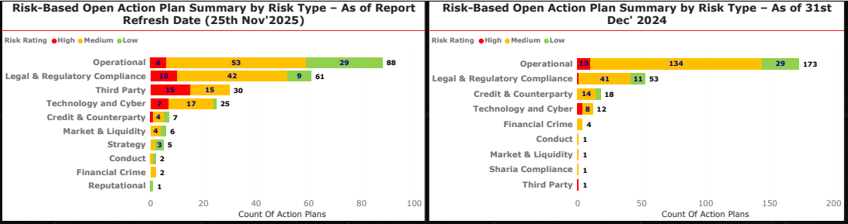
📃Daily Report
Risk Trends
Periodic Review of Open Action Plans, with Trend Analysis of Closures
* Data Analysis Time Period : 3rd June 2022 to 25th November 2025
Patterns Identified
Overall open action plans declined by 14%.
The most significant drop occurred in action plans related to Operational risks, indicating ~49% of reduction due to closure.
More than 60% reduction in Credit & Counterparty risk related action plans.
Increase in Legal & Regulatory Compliance, Third-Party, and Technology & Cyber risks, indicating expanded audit coverage in the latter part of the year.
9
Notes:
slicer
No alt text provided
slicer
No alt text provided
slicer
No alt text provided
shape
No alt text provided
Open Action Plan's Thematic Distribution
No alt text provided
Audit Details
No alt text provided
Risk Acceptance & Exemption (Division-wise)
No alt text provided
Audit Name
No alt text provided
card
No alt text provided
textbox
No alt text provided
Upcoming Action Plans
No alt text provided
Open Action Plans By Risk Rating
No alt text provided
actionButton
No alt text provided
Distribution Of Open Action Plans
No alt text provided
Action Plan Status - Last 3 Months
No alt text provided
Open Action Plans
No alt text provided
Open Overdue Action Plans
No alt text provided
Overdue (Under GIA Validation)
No alt text provided
Closed Action Plans - Last 30 Days
No alt text provided
Overdue Ageing For Open Action Plans
No alt text provided
shape
No alt text provided

Slide 10
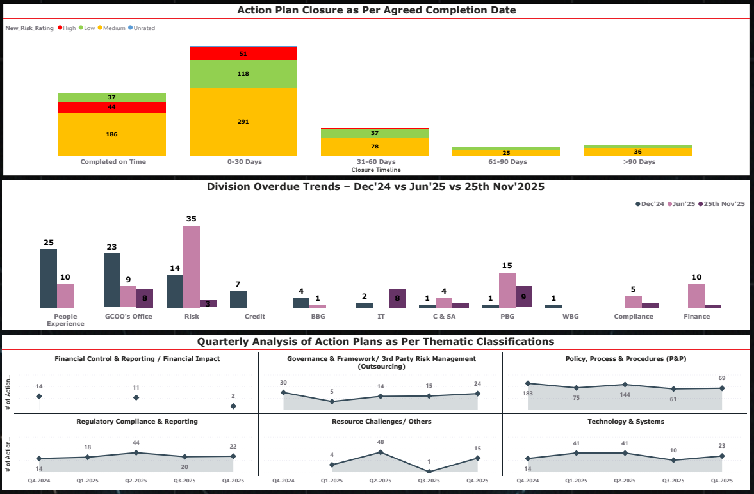
📃Daily Report
Risk Trends
This analysis tracks the progress of action plans & Thematic Reasons over the last four quarters which identifies recurring patterns and supports data-driven decision-making.
Patterns Identified
94% of high-risk action plans are closed either on time or within 30 days of agreed target date.
28% of action plans closed within the agreed timelines and 49% closed within 30 days of agreed target date.
Overall, the overdue trend shows improvement, with a noticeable decrease in overdue counts from the start of the period to date, reflecting timely closure of action plans.
People Experience as well as GCOO’s Office achieved noticeable improvement, reducing overdue counts.
Credit, BBG & WBG divisions has no overdue as of report refresh date.
Policy, Process & Procedures classification consistently dominated action plans but declined sharply from Q4‑2024 to Q4‑2025 reflecting improvement in the process.
Regulatory Compliance & Reporting classification peaked in Q2‑2025 before stabilizing, reflecting mid-year regulatory audit coverage.
* Data Analysis Time Period : 1st June 2024 to 25th November 2025
10
Notes:
slicer
No alt text provided
slicer
No alt text provided
slicer
No alt text provided
shape
No alt text provided
Open Action Plan's Thematic Distribution
No alt text provided
Audit Details
No alt text provided
Risk Acceptance & Exemption (Division-wise)
No alt text provided
Audit Name
No alt text provided
card
No alt text provided
textbox
No alt text provided
Upcoming Action Plans
No alt text provided
Open Action Plans By Risk Rating
No alt text provided
actionButton
No alt text provided
Distribution Of Open Action Plans
No alt text provided
Action Plan Status - Last 3 Months
No alt text provided
Open Action Plans
No alt text provided
Open Overdue Action Plans
No alt text provided
Overdue (Under GIA Validation)
No alt text provided
Closed Action Plans - Last 30 Days
No alt text provided
Overdue Ageing For Open Action Plans
No alt text provided
shape
No alt text provided

Slide 11

RAKBANK Open & Overdue Management Actions Update

Slide 12
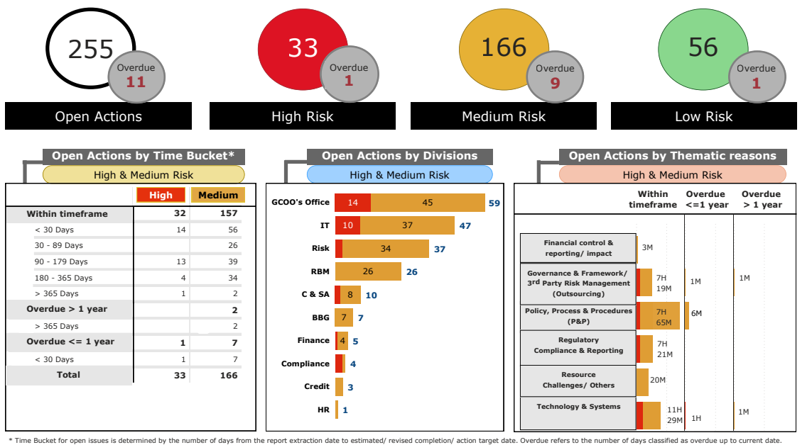
Open Management Actions – Aging Analysis (RAKBANK excl. RAKislamic & RAKINSURANCE)
Management Actions* released - 2025 YTD
93
497
200
Management Actions* closed - 2025 YTD
RBD
76
534
188
* Actions excludes those related to RAKislamic and RAKINSURANCE divisions, and Audit Reports recently released including actions from GIA audits; AFIs and unrated actions are also excluded.
12
Data as of 05-Dec-25

Slide 13
Management Actions Overdue < 30 days - HIGH Risk (RAKBANK)
S# | Audit Name | Issue | Management Action Summary | Owner & Last Agreed Date | Latest Update
1 | Pre-implementation Audit of Middleware and Application Programming Interfaces (APIs) Report Issue Date: 20-Feb-25 | Finding 1 – ARCOS Bypass and Absence of Log Integration | Log retention, extension feasibility and impact are being reviewed in coordination with vendor and internal teams, action plan and remediation timelines will be shared accordingly. | Saket Saith; Sh. Abdullah A. K. Al Qassemi 30-Nov-25 (Original ECD: 31-Mar-25) | Additional requested evidence has been submitted to GIA on 04/12/2025 which will be reviewed.

Slide 14
Management Actions Overdue > 90 days - MEDIUM Risk (RAKBANK)
S# | Audit Name | Issue | Management Action Summary | Owner & Last Agreed Date | Latest Update
1 | NESA Compliance 2020 Report Issue Date: 20-Apr-21 | Open risks and audit findings have been identified which are addressing NESA complaint gaps. | We will review the open risks and initiate exemption if no fix is available. | Saket Saith; Nilesh Haripersad; Original : 30-Sep-23 Risk Acceptance: 15-Dec-25 | Funding for the data masking capability has been approved at PEXCO on 26/11/2025. The project will be divided into 2 phases and phase 1 will start from December 2025. In the interim, a Risk Acceptance Form (RAF) has been documented and is currently under review by the CRO. Approval is expected around the second week of December. The initial submission in November 2025 was reviewed, but additional information was requested by Group Operational Risk, which has now been addressed.
2 | PCI Data Security Standards 2021 Report Issue Date: 15-Dec-21 | Missing preventive and monitoring controls for database administrators and application support teams’ access to sensitive card data. | IT will work with Security Operations to configure alerts for sensitive authentication and cardholder data tables using Arcos, Security Incident Event Management, or other approved tools. As a compensating control, database administrators & Application support team access databases through Arcos which maintains video recording of all actions performed. | Saket Saith; Sumat Kumar 30-Sep-24 Revised Date dependent on funding approval | The initial funding request (seed capital) for the DAM solution was not submitted to PEXCO on 26/11/2025 as planned, due to the absence of CAPEX under the 2025 budget. The request will be submitted for the January PEXCO meeting, where approval for the 2026 budget may be granted and utilized. Following the approval outcome, a detailed project plan will be developed.

Slide 15
Summary of Extensions on Management Actions (RAKBANK)
Process for the Extension of Management Action Due Dates
Summary of Extensions
Audit Name | Finding Name | Last Extension Date | Risk Rating
ATM Infrastructure | End of life (EOL) and End of support (EOS) hardware/software | 06-Nov-25 | Medium
RAK Business Loans | Pricing Reporting and monitoring | 24-Nov-25
Trade Finance Operation | TBML due diligence - Price Variance Checks | 4-Dec-25
Total Extensions between 16 Oct* to date |  | 3
Total Medium Extensions as of 4 Dec 2025 |  | 15
Total High Extensions as of 4 Dec 2025 |  | 5
Requests for management action due date extensions are subject to an approval
hierarchy as per the below matrix:
*GCEO: Group Chief Executive Officer *GMC: respective Group Management Committee member *GCAO: Group Chief Audit Officer *SMT: respective member of GIA Senior Management Team *HOD: respective Head of Department
Key Highlights of the Extension Process
*Last date of reporting of extensions to BAC
Extension Request Submission​
Requests must be submitted one month before due dates with valid rationale and hierarchy approval.​
Approval Authority Based on Risk​
High and Medium risk extensions require GCAO approval; Low risk extensions are approved by SMT.​
Extension Limits and Documentation​
Maximum extension is six months; project-related/IT system dependencies extensions can extend to one year with documented evidence.​
Transparency and Restrictions​
Extensions marked as 'Open’ actions and summarized monthly; no extensions for Very High risk or regulatory non-compliance.

Slide 16

GIA Validations – CBUAE Reviews - Update as of 4th of December 2025
CBUAE Action Closure Requirements:
01
02
03
04
05
Actions reviewed and agreed by Group Management Committee (GMC) Member; and Compliance and GIA. Progress tracked by Project Management Office (PMO)
Action completed then approved by GMC member. Owner collates evidence to share with GIA.
Validation by GIA to confirm action completed as agreed, by due date and evidenced.
Compliance* review and approve the completion of the validation.
Closure and GIA validation presented to BAC.
* For actions pertaining to Compliance, the review and approval of the completion of validation has been performed by a third party (Ernst & Young) to avoid any conflict of interest.
CBUAE Examination | #Findings | #Actions | Resolved by Action Owner & updated in TeamMate | Under review by GIA | Validated by GIA | Closed post Compliance/ EY Review
Baseline Examination 2022 | 122 | 299 | 298 | - | 298 | 298
BRF Thematic Review 2023 | 5 | 13 | 12 | - | 12 | 12
Control Functions Limited scope Examination 2025 | 14 | 28 | - | - | - | -
Market Conduct Limited Scope Examination 2025 | 9 | 54 | 30 | 2 | 28 | 28
Shari’ah Examination 2025 | 6 | 17 | - | - | - | -
AML/CFT Follow-up Examination 2025 | 23 | 55 | - | - | - | -
Total | 179 | 466 | 340 | 2 | 338 | 338
All CBUAE examinations where actions have been completely remediated, validated and closed are not shown in this table

Slide 17
Summary: CBUAE Limited Scope Examination : GIA Responses to CBUAE
S# | Observation (Summary) | Risk Impact | Action Required (Summary) | GIA : Responses to CBUAE | GIA Comments / Current Status
1 | GIA has 5 vacancies, achieving only 76% of the 2024 audit plan. No formalized training plan; inconsistent training levels among staff. Skills gaps identified in model risk, cyber security, and climate risk. | Medium | Allocate adequate resources to complete the audit plan and develop a formal training plan covering skills, grade, and focus area. | Recruitment is in progress to fill the remaining vacancies; 84% audit plan completion was achieved with remaining work completed in Q1 2025. A staff capacity analysis will be performed for the FY 2026 Audit Plan. GIA's Training Plan will be enhanced, reflecting skill assessment results and aligned to the upcoming audit plan. External expertise will continue to be used where needed. | In progress. Recruitment for 3 remaining approved vacancies in progress; Year-End. Will be performed as part of FY’26 Annual Audit Plan exercise in Q4’2025 In progress. GIA is liaising with Learning and Development team; Session on Global Internal Audit Standards and Professional Ethics conducted for team.
2 | Risk assessment is not linked to the audit cycle, resulting in critical areas not being audited timely. ICAAP and Risk Management audits lacked report ratings. | Medium | Link audit risk assessment to audit cycle frequency; rate all critical area audits including ICAAP and Risk Management. | Risk assessment is now clearly linked to the 3-year audit cycle. The 1+2 Audit Plan prioritizes high-risk areas. Starting 2026, formal mapping will evidence this linkage. ICAAP and Regulatory Stress Test will be rated in future plans. | Completed. Completed. Linkage of the Audit Universe and Plan defined in updated GIA Manual; Sections 7.6.11 and 7.9.1c Completed. Regulatory Stress Test report has now been issued with a rating.
3 | MI dashboard has limited visibility on extensions. Inconsistencies exist between Teammate and formal audit report ratings, causing data gaps. | Medium | Enhance MI reporting to align with the extension process and ensure consistency between systems and reports. | The new MI dashboard was launched; inconsistencies are being resolved through data validation. Ratings for critical reviews will be documented and included. Unrated minor reviews will remain as such, with individual findings not rated. | Completed. Inconsistencies have been resolved. Completed. Ratings methodology for all reports including critical Regulatory Mandated Reviews has been defined in the updated GIA Manual. Additionally, the latest Regulatory Stress Test report has now been issued with a rating.
4 | Follow-up process not formalized in the GIA Manual. Outdated 2022 charter still on the bank's website, despite internal update in 2024. | Low | Update GIA manual and policies to reflect current practices; publish latest charter on the bank’s website. | The Audit Manual is updated every two years. The next version (August 2025) will incorporate recent changes, including follow-up and tracking. The latest Internal Audit Charter (2024) will be published on the bank’s website to ensure alignment with internal policies. A process has been established to ensure timely updating and publishing of all governance documents. | Completed. Audit Manual has been updated to incorporate the recent changes including follow-up on audit issues. Completed. Latest GIA Charter is available both on Intranet and Bank’s website. Completed. GIA Charter has been updated and submitted to BAC for approval in July 2025; will be updated on intranet and website upon approval.
5 | No documentation provided to evidence an annual BAC performance assessment of GIA. | Low | Ensure annual performance evaluation of GIA by the Board or BAC is conducted and documented. | A BAC performance survey was completed in early 2025. Going forward, performance evaluation will be formally documented and retained as part of BAC records and minutes. | Completed. Additionally GIA performance survey will be shared with BAC after December meeting. Year-End. Will be performed as part of year end exercise and BAC evaluation of GIA will be formally documented.
**Completed actions will be validated by an independent party in January 2026, followed by confirmation of closure by Compliance.

Slide 18












Quality Assurance & Improvement Program
GIA has aligned its practices with the 2025 Global Internal Audit Standards, reflecting our commitment to professional excellence & adoption of leading practices. The revised GIA Manual issued in September 2025, incorporates contemporary audit approaches & enhanced quality standards.
Strengthened Standards, Methodology & Governance
Standards
Methodology
GIA Manual
Revised GIA Manual updated to reflect current audit practices, refreshed methodologies and execution protocols, and fully aligned with the 2025 Global Internal Audit Standards (GIAS) — establishing a consistent baseline across all audit teams.
Revised GIA Manual; GIAS Alignment
QA Review & Rating, QA Checkpoints
QAIP 2025
GIA Strategy 2025-2026
Implemented, reinforcing quality, governance, talent development and digital enablement.
QA Review Methodology
Governance
Internal Assessments
Rolled out the formal QA Review & Rating Methodology, introducing a structured conformance scale (Conforms / Partially Conforms / Does Not Conform) and embedding enhanced QA checkpoints into planning, fieldwork and reporting.
GIA Strategy FY2025-26
Thematic QA Insights; EQA Readiness
Thematic QA Insights
Quality reviews and thematic assessments across all Group Internal Audit verticals identified consistent improvement opportunities:
Supervision & Documentation
Issue Governance
⭐
Planning & Scope
Ratings & Reporting
Continuous Improvement
Time & Resource
Stronger scope definitions, rationale for exclusions, and improved alignment across audit teams.
Enhanced supervisory visibility, workpapers, and clearer audit trails.
Greater discipline in issue tracking within TeamMate+ system to support accurate dashboards & timely follow-up.
Sharper justification of severity ratings and transparent change-control between draft & final reports.
Improved tracking of budgeted vs. actual man-days & stronger documentation for variances.
QA themes addressed through updated templates, guidance, calibration and QA routines
GIA continues to strengthen assurance maturity through standards alignment, methodological consistency and thematic QA insights across the audit lifecycle.
18

